Slide 1


The PiXL Club The PiXL Club The PiXL Club The PiXL Club The PiXL Club The PiXL Club The PiXL Club The PiXL Club The PiXL Club The PiXL Club The PiXL Club The PiXL Club The PiXL Club The PiXL Club The PiXL Club The PiXL Club The PiXL Club The PiXL Club The PiXL Club The PiXL Club The PiXL Club The PiXL Club The PiXL Club The PiXL Club The PiXL Club The PiXL Club The PiXL Club The PiXL Club The PiXL Club The PiXL Club The PiXL Club The PiXL Club The PiXL Club The PiXL Club The PiXL Club The PiXL Club The PiXL Club The PiXL Club The PiXL Club The PiXL Club The PiXL Club The PiXL Club The PiXL Club The PiXL Club The PiXL Club XL Club The PiXL Club The PiXL Club The PiXL Club The PiXL Club The PiXL Club The PiXL Club The PiXL Club The PiXL Club The PiXL Club The PiXL Club The PiXL Club The PiXL Club The PiXL Club The PiXL Club The PiXL Club The PiXL Club The PiXL Club The PiXL Club The PiXL Club The PiXL Club The PiXL Club The PiXL Club The PiXL Club The PiXL Club The PiXL Club The PiXL Club The PiXL Club The PiXL Club The PiXL Club The PiXL Club The PiXL Club The PiXL Club The PiXL Club The PiXL Club The PiXL Club The PiXL Club The PiXL Club The PiXL Club The PiXL Club The PiXL Club The PiXL Club The PiXL Club The PiXL Club The PiXL Club The PiXL Club The PiXL Club The PiXL Club The PiXL Club The PiXL Club The PiXL Club The PiXL Club The PiXL Club The PiXL Club The PiXL Club The PiXL Club The PiXL Club The PiXL Club The PiXL Club The PiXL Club The PiXL Club The PiXL Club The PiXL Club The PiXL Club The PiXL Club The PiXL Club The PiXL Club The PiXL Club The PiXL Club The PiXL Club The PiXL Club The PiXL Club The PiXL Club The PiXL Club The PiXL Club The PiXL Club The PiXL Club The PiXL Club The PiXL Club The PiXL Club The PiXL Club The PiXL Club The PiXL Club The PiXL Club The PiXL Club The PiXL Club The PiXL Club The PiXL Club The PiXL Club The PiXL Club The PiXL Club The PiXL Club The PiXL Club The PiXL Club The PiXL Club The PiXL Club The PiXL Club The PiXL Club The PiXL Club The PiXL Club The PiXL Club The PiXL Club The PiXL Club The PiXL Club The PiXL Club The PiXL Club The PiXL Club The PiXL Club The PiXL Club The PiXL Club The PiXL Club The PiXL Club The PiXL Club The PiXL Club The PiXL Club The PiXL Club The PiXL Club The PiXL Club The PiXL Club The PiXL Club The PiXL Club The PiXL Club The PiXL Club The PiXL Club The PiXL Club The PiXL Club The PiXL Club The PiXL Club The PiXL Club The PiXL Club The PiXL Club The PiXL Club The PiXL Club The PiXL Club The PiXL Club The PiXL Club The PiXL Club The PiXL Club The PiXL Club The PiXL Club The PiXL Club The PiXL Club The PiXL Club The PiXL Club The PiXL Club The PiXL Club The PiXL Club The PiXL Club The PiXL Club The PiXL Club The PiXL Club The PiXL Club The PiXL Club The PiXL Club The PiXL Club The PiXL Club The PiXL Club The PiXL Club The PiXL Club The PiXL Club The PiXL Club The PiXL Club The PiXL Club The PiXL Club The PiXL Club The PiXL Club The PiXL Club The PiXL Club The PiXL Club The PiXL Club The PiXL Club The PiXL Club The PiXL Club The PiXL Club The PiXL Club The PiXL Club The PiXL Club The PiXL Club The PiXL Club The PiXL Club The PiXL Club The PiXL Club The PiXL Club The PiXL Club The PiXL Club The PiXL Club The PiXL Club The PiXL Club The PiXL Club The PiXL Club The PiXL Club The PiXL Club The PiXL Club The PiXL Club The PiXL Club The PiXL Club The PiXL Club The PiXL Club The PiXL Club The PiXL Club The PiXL Club The PiXL Club The PiXL Club The PiXL Club The PiXL Club The PiXL Club The PiXL Club The PiXL Club The PiXL Club The PiXL Club The PiXL Club The PiXL Club The PiXL Club The PiXL Club The PiXL Club The PiXL Club The PiXL Club The PiXL Club The PiXL Club The PiXL Club The PiXL Club The PiXL Club The PiXL Club The PiXL Club The PiXL Club The PiXL Club The PiXL Club The PiXL Club The PiXL Club The PiXL Club The PiXL Club The PiXL Club The PiXL Club The PiXL Club The PiXL Club The PiXL Club The PiXL Club The PiXL Club The PiXL Club The PiXL Club The PiXL Club The PiXL Club The PiXL Club The PiXL Club The PiXL Club The PiXL Club The PiXL Club The PiXL Club The PiXL Club The PiXL Club The PiXL Club The PiXL Club The PiXL Club The PiXL Club The PiXL Club The PiXL Club The PiXL Club The PiXL Club The PiXL Club The PiXL Club The PiXL Club The PiXL Club The PiXL Club The PiXL Club The PiXL Club The PiXL Club The PiXL Club The PiXL Club The PiXL Club The PiXL Club The PiXL Club The PiXL Club The PiXL Club The PiXL Club The PiXL Club The PiXL Club The PiXL Club The PiXL Club The PiXL Club The PiXL Club The PiXL Club The PiXL Club The PiXL Club The PiXL Club The PiXL Club The PiXL Club The PiXL Club The PiXL Club The PiXL Club The PiXL Club The PiXL Club The PiXL Club The PiXL Club The PiXL Club The PiXL Club The PiXL Club The PiXL Club The PiXL Club The PiXL Club The PiXL Club The PiXL Club The PiXL Club The PiXL Club The PiXL Club The PiXL Club The PiXL Club The PiXL Club The PiXL Club The PiXL Club The PiXL Club The PiXL Club The PiXL Club The PiXL Club The PiXL Club The PiXL Club The PiXL Club The PiXL Club The PiXL Club The PiXL Club The PiXL Club The PiXL Club The PiXL Club The PiXL Club The PiXL Club The PiXL Club The PiXL Club The PiXL Club The PiXL Club The PiXL Club The PiXL Club The PiXL Club The PiXL Club The PiXL Club The PiXL Club The PiXL Club The PiXL Club The PiXL Club The PiXL Club The PiXL Club The PiXL Club The PiXL Club The PiXL Club The PiXL Club The PiXL Club The PiXL Club The PiXL Club The PiXL Club The PiXL Club The PiXL Club The PiXL Club The PiXL Club The PiXL Club The PiXL Club The PiXL Club The PiXL Club The PiXL Club The PiXL Club The PiXL Club The PiXL Club The PiXL Club The PiXL Club The PiXL Club The PiXL Club The PiXL Club The PiXL Club The PiXL Club The PiXL Club The PiXL Club The PiXL Club The PiXL Club The PiXL Club The PiXL Club The PiXL Club The PiXL Club The PiXL Club The PiXL Club The PiXL Club The PiXL Club The PiXL Club The PiXL Club The PiXL Club The PiXL Club The PiXL Club The PiXL Club The PiXL Club The PiXL Club The PiXL Club The PiXL Club The PiXL Club The PiXL Club The PiXL Club The PiXL Club The PiXL Club The PiXL Club The PiXL Club The PiXL Club The PiXL Club The PiXL Club The PiXL Club The PiXL Club The PiXL Club The PiXL Club The PiXL Club The PiXL Club The PiXL Club The PiXL Club The PiXL Club The PiXL Club The PiXL Club The PiXL Club The PiXL Club The PiXL Club The PiXL Club The PiXL Club The PiXL Club The PiXL Club The PiXL Club The PiXL Club The PiXL Club The PiXL Club The PiXL Club The PiXL Club The PiXL Club The PiXL Club The PiXL Club The PiXL Club The PiXL Club The PiXL Club The PiXL Club The PiXL Club The PiXL Club The PiXL Club The PiXL Club The PiXL Club The PiXL Club The PiXL Club The PiXL Club The PiXL Club The PiXL Club The PiXL Club The PiXL Club The PiXL Club The PiXL Club The PiXL Club The PiXL Club The PiXL Club The PiXL Club The PiXL Club The PiXL Club The PiXL Club The PiXL Club The PiXL Club The PiXL Club The PiXL Club The PiXL Club The PiXL Club The PiXL Club The PiXL Club The PiXL Club The PiXL Club The PiXL Club The PiXL Club The PiXL Club The PiXL Club The PiXL Club The PiXL Club The PiXL Club The PiXL Club The PiXL Club The PiXL Club The PiXL Club The PiXL Club The PiXL Club The PiXL Club The PiXL Club The PiXL Club The PiXL Club The PiXL Club The PiXL Club The PiXL Club The PiXL Club The PiXL Club The PiXL Club The PiXL Club The PiXL Club The PiXL Club The PiXL Club The PiXL Club The PiXL Club The PiXL Club The PiXL Club The PiXL Club The PiXL Club The PiXL Club The PiXL Club The PiXL Club The PiXL Club The PiXL Club The PiXL Club The PiXL Club The PiXL Club The PiXL Club The PiXL Club The PiXL Club The PiXL Club The PiXL Club The PiXL Club The PiXL Club The PiXL Club The PiXL Club The PiXL Club The PiXL Club The PiXL Club The PiXL Club The PiXL Club The PiXL Club The PiXL Club The PiXL Club The PiXL Club The PiXL Club The PiXL Club The PiXL Club The PiXL Club The PiXL Club The PiXL Club The PiXL Club The PiXL Club The PiXL Club The PiXL Club The PiXL Club The PiXL Club The PiXL Club The PiXL Club The PiXL Club The PiXL Club The PiXL Club The PiXL Club The PiXL Club The PiXL Club The PiXL Club The PiXL Club The PiXL Club The PiXL Club The PiXL Club The PiXL Club The PiXL Club The PiXL Club The PiXL Club The PiXL Club The PiXL Club The PiXL Club The PiXL Club The PiXL Club The PiXL Club The PiXL Club The PiXL Club The PiXL Club The PiXL Club The PiXL Club The PiXL Club The PiXL Club The PiXL Club The PiXL Club The PiXL Club The PiXL Club The PiXL Club The PiXL Club The PiXL Club The PiXL Club The PiXL Club The PiXL Club The PiXL Club The PiXL Club The PiXL Club The PiXL Club The PiXL Club The PiXL Club The PiXL Club The PiXL Club The PiXL Club The PiXL Club The PiXL Club The PiXL Club The PiXL Club The PiXL Club The PiXL Club The PiXL Club The PiXL Club The PiXL Club The PiXL Club The PiXL Club The PiXL Club The PiXL Club The PiXL Club The PiXL Club The PiXL Club The PiXL Club The PiXL Club The PiXL Club The PiXL Club The PiXL Club The PiXL Club The PiXL Club The PiXL Club The PiXL Club The PiXL Club The PiXL Club The PiXL Club The PiXL Club The PiXL Club The PiXL Club The PiXL Club The PiXL Club The PiXL Club The PiXL Club The PiXL Club The PiXL Club The PiXL Club The PiXL Club The PiXL Club The PiXL Club The PiXL Club The PiXL Club The PiXL Club The PiXL Club The PiXL Club The PiXL Club The PiXL Club The PiXL Club The PiXL Club The PiXL Club The PiXL Club The PiXL Club The PiXL Club The PiXL Club The PiXL Club The PiXL Club The PiXL Club The PiXL Club The PiXL Club The PiXL Club The PiXL Club The PiXL Club The PiXL Club The PiXL Club The PiXL Club The PiXL Club The PiXL Club The PiXL Club The PiXL Club The PiXL Club The PiXL Club The PiXL Club The PiXL Club The PiXL Club The PiXL Club The PiXL Club The PiXL Club The PiXL Club The PiXL Club The PiXL Club The PiXL Club The PiXL Club The PiXL Club The PiXL Club The PiXL Club The PiXL Club The PiXL Club The PiXL Club The PiXL Club The PiXL Club The PiXL Club The PiXL Club The PiXL Club The PiXL Club The PiXL Club The PiXL Club The PiXL Club The PiXL Club The PiXL Club The PiXL Club The PiXL Club The PiXL Club The PiXL Club The PiXL Club The PiXL Club The PiXL Club The PiXL Club The PiXL Club The PiXL Club The PiXL Club The PiXL Club The PiXL Club The PiXL Club The PiXL Club The PiXL Club The PiXL Club The PiXL Club The PiXL Club The PiXL Club The PiXL Club
PiXL KnowIT!
GCSE Chemistry
Edexcel Topic – Fuels and Earth Science
© Copyright The PiXL Club Ltd, 2017
This resource is strictly for the use of member schools for as long as they remain members of The PiXL Club. It may not be copied, sold nor transferred to a third party or used by the school after membership ceases. Until such time it may be freely used within the member school.
All opinions and contributions are those of the authors. The contents of this resource are not connected with nor endorsed by any other company, organisation or institution.
www.pixl.org.uk The PiXL Club Ltd, Company number 07321607

Slide 2
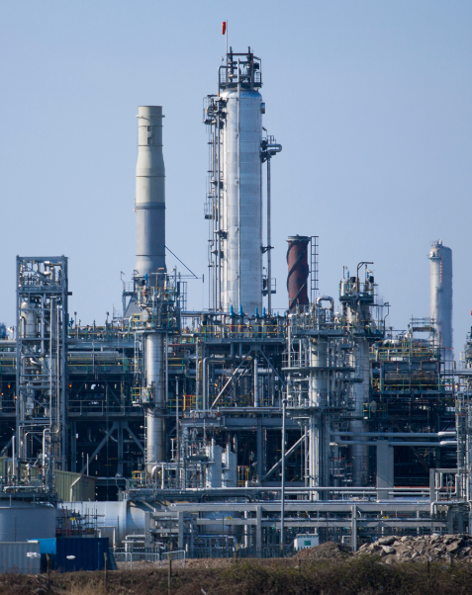
Overview Fuels and Earth Sciences
Fuels
Crude oil, hydrocarbons, alkanes
and fractional distillation
Combustion and pollution
Cracking
Earth and atmospheric science
Earth’s early atmosphere
The greenhouse effect and climate change
Today’s atmosphere

Slide 3
LearnIT!
KnowIT!
Fuels – Part 1
Crude oil, hydrocarbons, alkanes and fractional distillation

Slide 4
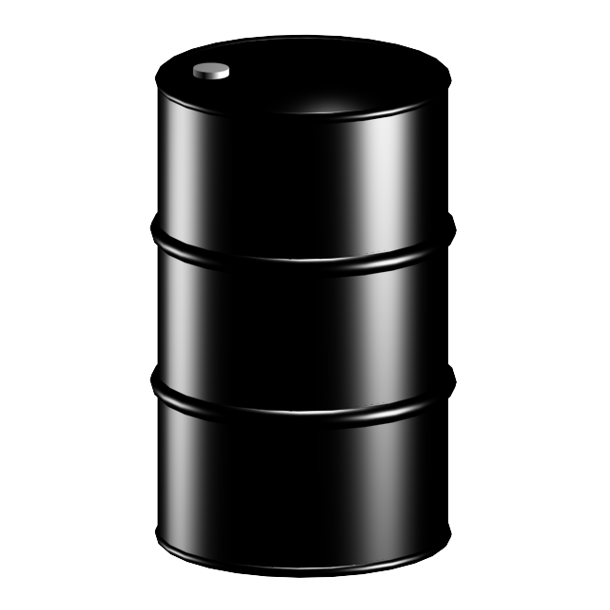
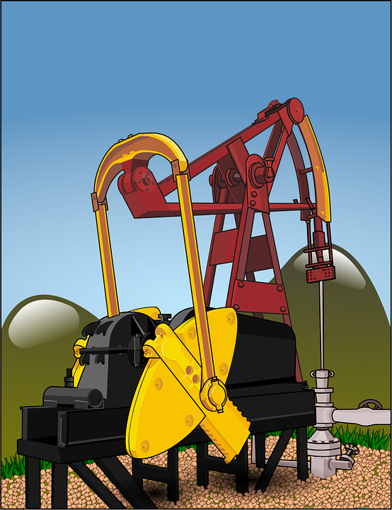
Crude oil and hydrocarbons
Crude oil is a finite resource containing a complex mixture of hydrocarbons.
It contains molecules in which carbon atoms are in chains or rings and is an important source of useful substances such as fuels and feedstock for the petrochemical industry.
The two definitions are very important. You must learn both of them.
Hydrocarbons are compounds that contain hydrogen and carbon only.

Slide 5
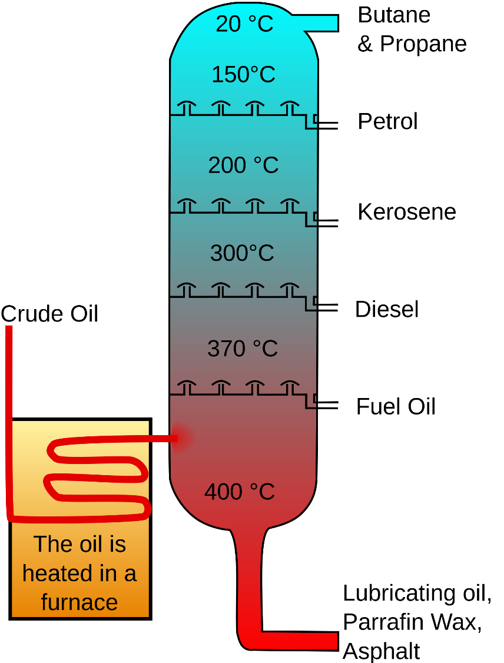
Fractional distillation
The many hydrocarbons in crude oil may be separated into fractions, each of which contains molecules with a similar number of carbon atoms by fractional distillation.
Below is a diagram of a fractional distillation column, learn the order of the fractions on the right hand side
If we look at the diagram on the right all the hydrocarbon molecules are in the highest fraction – liquefied petroleum gases will have between 1 and 4 carbons. All the hydrocarbon molecules in petrol will have between 5 and 9 carbons.
Some properties of hydrocarbons depend on the size of their molecules, including:
Boiling point
Viscosity
Flammability
These change with increasing molecular size.
We know that as we go up the fractional distillation column, the boiling point and viscosity decrease and the flammability increases.

Slide 6
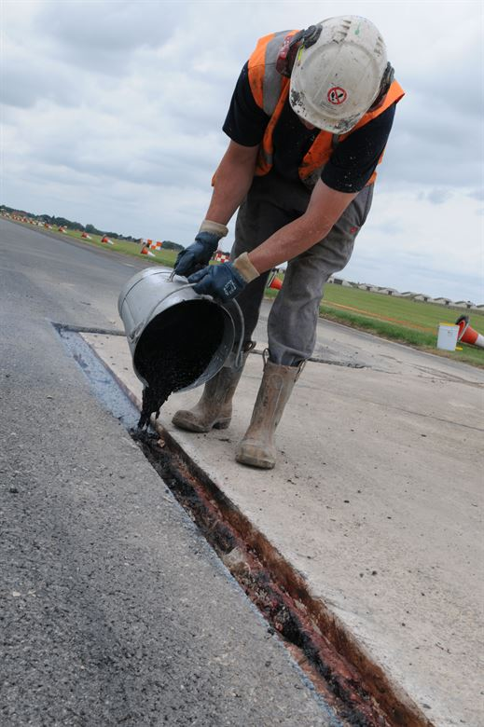
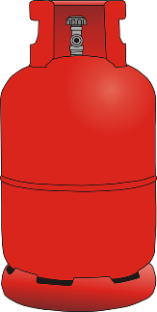
Fractional distillation
The fractions produced in fractional distillation can be processed to produce fuels e.g. petrol, and feedstock (reactants for further chemical reactions) for the petrochemical industry.
Examples of fractions and their uses are:
Gases, used in domestic heating and cooking
Petrol, used as a fuel in cars
Kerosene, used as fuel for aircraft
Diesel oil, used as a fuel for some cars and trains
Fuel oil, used as fuel for large ships and some power stations
Bitumen, used to surface roads and roofs

Slide 7
Crude oil, hydrocarbons and alkanes
Most of the hydrocarbons in crude oil are hydrocarbons called alkanes.
Alkanes form part of a homologous series with the same general formula C_{n}H_{2n+2}
A homologous series is a series of compounds which:
Have the same general formula e.g. C_{n}H_{2n+2} for alkanes
Differ by CH₂ in molecular formulae from neighbouring compounds e.g. Methane = CH₄, ethane = C₂H₆
Show a gradual variation in physical properties e.g. increasing length of carbon chain for alkanes increases the boiling point; methane = -162ºC, ethane = -89ºC.
Have similar chemical properties

Slide 8
QuestionIT!
Fuels – Part 1
Crude oil, hydrocarbons, alkanes and fractional distillation

Slide 9
Crude oil, hydrocarbons and alkanes– QuestionIT
Crude oil is a finite resource. What does finite mean?
What is crude oil?
What is the definition of a hydrocarbon?
What is the general formula of the alkanes?
What would be the formula of an alkane with nine carbons?

Slide 10
Crude oil, hydrocarbons and alkanes - QuestionIT
What do we call the many hydrocarbons in crude oil?
How can the hydrocarbons in crude oil be separated out?
List the following fractions from fractional distillation in order of boiling point (the fraction with the lowest boiling point should be first).
Kerosene, diesel oil, heavy fuel oil, liquefied petroleum gases, petrol.

Slide 11
Crude oil, hydrocarbons and alkanes QuestionIT
How would you describe the boiling point, the viscosity and the flammability of a very large alkane molecule?
State the uses of the following fractions of crude oil:
Gases
Kerosene
Fuel oil
Bitumen

Slide 12

AnswerIT!
Fuels – Part 1
Crude oil, hydrocarbons alkanes and fractional distillation

Slide 13
Crude oil, hydrocarbons and alkanes– QuestionIT
Crude oil is a finite resource. What does finite mean?
Being used up faster than it is being formed.
What is crude oil?
Mixture of a very large number of compounds, most of which are hydrocarbons. A finite resource containing molecules in which carbon atoms are in chains or rings and an important source of fuels and feedstock.
What is the definition of a hydrocarbon?
Compound containing hydrogen and carbon only.

Slide 14
Crude oil, hydrocarbons and alkanes– QuestionIT
What is the general formula of the alkanes?
C_{n}H_{2n+2}
What would be the formula of an alkane with nine carbons?
C₉H₂₀

Slide 15
Crude oil, hydrocarbons and alkanes - QuestionIT
What do we call the many hydrocarbons in crude oil?
Fractions.
How can the hydrocarbons in crude oil be separated out?
Fractional distillation.
List the following fractions from fractional distillation in order of boiling point (the fraction with the lowest boiling point should be first).
Kerosene, diesel oil, heavy fuel oil, liquefied petroleum gases, petrol.
LPG, petrol, diesel oil, kerosene, heavy fuel oil

Slide 16
Crude oil, hydrocarbons and alkanes - QuestionIT
How would you describe the boiling point, the viscosity and the flammability of a very large alkane molecule?
High boiling point, high viscosity, low flammability.
State the uses of the following fractions of crude oil:
Gases heating and cooking
Kerosene fuel for aircraft
Fuel oil Fuel for large ships and power stations
Bitumen surface roads and roofs

Slide 17
LearnIT!
KnowIT!
Fuels – Part 2
Combustion and
pollution

Slide 18
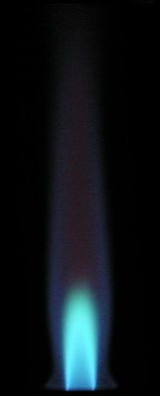

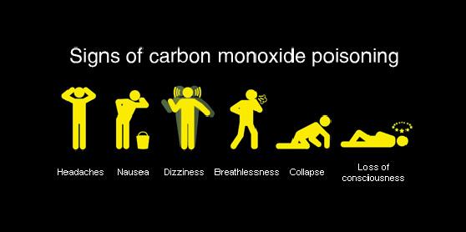
Common atmospheric pollutants and their sources
The complete combustion of hydrocarbons as fuels releases energy and produces carbon dioxide and water.
Incomplete combustion occurs when there is a lack of oxygen, consequently producing carbon monoxide and carbon (soot) rather than carbon dioxide.
CH₄ + O₂ → H₂O + CO₂
Appliances, such as domestic boilers, can carry out incomplete combustion if there is insufficient oxygen. Soot will build up inside the appliance and toxic carbon monoxide will be released.

Slide 19
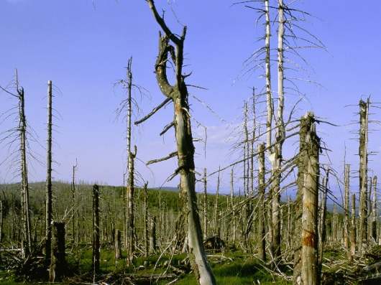
Common atmospheric pollutants and their sources
The gases released into the atmosphere when a fuel is burnt may include carbon dioxide, water vapour, carbon monoxide, sulfur dioxide and oxides of nitrogen. Solid particles and unburned hydrocarbons may also be released, forming particulates in the atmosphere.
Carbon monoxide is a toxic gas. It is colourless and odourless and so is not easily detected.
Sulfur dioxide from impurities in some hydrocarbon fuels. When sulfur dioxide dissolves in rainwater it produces acid rain, which can lead to acidification of lakes, destruction of trees and weathering of rocks and buildings.
When fuels are burnt in engines, oxygen and nitrogen can react together at high temperatures to produce oxides of nitrogen which are also pollutants.

Slide 20
Hydrogen versus petrol
Hydrogen | Petrol
Product is water, no harmful CO₂ or oxides of nitrogen produced by car. Hydrogen fuel cells are very efficient. Most hydrogen is produced by reacting steam with non-renewable coal or natural gas. Few filling stations selling hydrogen. Hydrogen has to be compressed and liquefied, stored in tough insulated tanks. Does not work at very low temperatures. | Products are water and CO_{2,} a greenhouse gas. Produces oxides of nitrogen. Petrol is a fraction of the non-renewable crude oil. Produces large amounts of energy. Lots of petrol stations available to fill up the car. Easily stored and transported. Works at low temperatures.

Slide 21
QuestionIT!
Fuels – Part 2
Combustion and
pollution

Slide 22
Common atmospheric pollutants and their sources - QuestionIT
What are the two main elements in most fuels?
What other potentially polluting element may be present in fossil fuels?
What gases may be released into the atmosphere when a fuel is burned?
Which of these gases can lead to acid rain?
Write the balanced symbol equation for the complete combustion of pentane C₅H₁₂ .

Slide 23
Common atmospheric pollutants and their sources - QuestionIT
Which two substances would be formed if this was an incomplete combustion reaction?
Describe the gas, carbon monoxide.
Why is carbon monoxide difficult to detect?
Give two advantages of using hydrogen in cars, rather than petrol.
Give two advantages of using petrol in cars, rather than hydrogen.

Slide 24
AnswerIT!
Fuels – Part 2
Combustion and
pollution

Slide 25
Common atmospheric pollutants and their sources - QuestionIT
What are the two main elements in most fuels?
Hydrogen and carbon.
What other potentially polluting element may be present in fossil fuels?
Sulfur.
What gases may be released into the atmosphere when a fuel is burned?
Carbon dioxide, water vapour, carbon monoxide, sulfur dioxide and oxides of nitrogen.
Which of these gases can lead to acid rain?
Sulfur dioxide.

Slide 26
Common atmospheric pollutants and their sources - QuestionIT
Write the balanced symbol equation for the complete combustion of pentane C₅H₁₂ .
C₅H₁₂ + 8O₂ 5CO₂ + 6H₂O
Which two substances would be formed if this was an incomplete combustion reaction?
Water and carbon monoxide and/ or soot
Describe the gas, carbon monoxide.
Toxic gas; colourless and odourless.
Why is carbon monoxide difficult to detect?
Colourless and odourless.
Give two advantages of using hydrogen in cars, rather than petrol.
No CO₂ or oxide of nitrogen emissions by the car; very efficient.
Give two advantages of using petrol in cars, rather than hydrogen.
Lots of filling stations available, works at low temperature, produces a lot of energy.

Slide 27
LearnIT!
KnowIT!
Fuels – Part 3
Cracking

Slide 28
Cracking and alkenes
Larger saturated hydrocarbons can be broken down (cracked) to produce smaller more useful molecules. Some of which are unsaturated alkenes.
This is an important definition.
C₁₀H₂₂ → C₈H₁₈ + C₂H₄
The two products made are both more useful than the starting hydrocarbon, but notice that there are always the same number of carbons and hydrogens on the left hand side of the equation and on the right hand side.
Cracking is necessary to produce useful short chain hydrocarbons, such as petrol, from longer less useful hydrocarbons. It requires a high temperature and a catalyst.
Remember: Petrol, kerosene and diesel oil are non-renewable fossil fuels obtained from crude oil; and methane is a non-renewable fossil fuel found in natural gas.

Slide 29
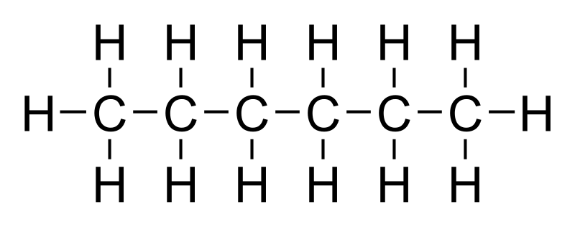
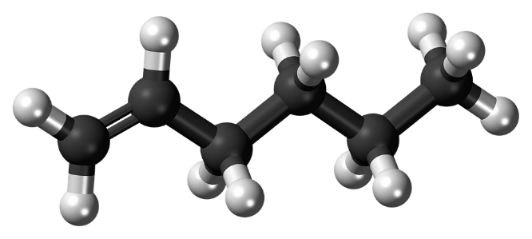
Cracking and alkenes
The products of cracking include alkanes and another type of hydrocarbon called alkenes.
Alkenes are more reactive than alkanes. There is a high demand for fuels with small molecules and so some of the products of cracking are useful as fuels.
Alkanes are saturated hydrocarbons – there are no double bonds between carbons.
Alkenes are unsaturated hydrocarbons – there are one or more double bonds between carbons.
Alkenes are used to produce polymers and as starting materials for the production of many other chemicals.

Slide 30
QuestionIT!
Fuels – Part 3
Cracking

Slide 31
Cracking- QuestionIT
Define the term ‘cracking’.
Where do the non-renewable fossil fuels petrol and kerosene come from?
Where does the non-renewable fossil fuel methane come from?
Why is cracking necessary?
What is an alkene?

Slide 32
AnswerIT!
Fuels – Part 3
Cracking

Slide 33
Cracking- QuestionIT
Define the term ‘cracking’.
Breakdown of larger saturated hydrocarbons into shorter hydrocarbons, some of which are unsaturated.
Where do the non-renewable fossil fuels petrol and kerosene come from?
Crude oil.
Where does the non-renewable fossil fuel methane come from?
Natural gas
Why is cracking necessary?
Break longer saturated, less useful hydrocarbons, into shorted more useful hydrocarbons, some of which are unsaturated alkenes.
What is an alkene?
Unsaturated hydrocarbon; one or more double bond between carbons.

Slide 34
LearnIT!
KnowIT!
Earth and atmospheric science
Part 1
The Earth’s early atmosphere
Changes in atmospheric gases

Slide 35

The Earth’s early atmosphere
Theories about what was in the Earth’s early atmosphere and how the atmosphere was formed have changed and developed over time. Evidence for the early atmosphere is limited because of the time scale of 4.6 billion years.
There are a number of different theories as to how the atmosphere evolved.
One theory suggests:
During the first billion years there was intense volcanic activity that released gases that formed the early atmosphere consisting of mainly carbon dioxide with little or no oxygen gas.
Water vapour condensed to form the oceans.
Volcanoes also produced nitrogen which gradually built up in the atmosphere and there may have been small proportions of methane and ammonia.
When the oceans formed, carbon dioxide dissolved in the water and carbonates were precipitated producing sediments, reducing the amount of carbon dioxide in the atmosphere.
CO₂, N₂, H₂O

Slide 36
How oxygen increased and carbon dioxide decreased
Organisms evolved that changed the atmosphere in a significant way.
Primitive plants produced the oxygen that is now in the atmosphere by photosynthesis, which can be represented by the equation:
6CO₂ + 6H₂O C₆H₁₂O₆ + 6O₂
Carbon dioxide + water glucose + oxygen
light
Algae first produced oxygen about 2.7 billion years ago and soon after this oxygen appeared in the atmosphere. Over the next billion years plants evolved and the percentage of oxygen gradually increased to a level that enabled animals to evolve.
Plants decreased the percentage of carbon dioxide in the atmosphere by photosynthesis. Carbon dioxide was also decreased by the formation of sedimentary rocks and fossil fuels that contain carbon.
Oxygen increases due to photosynthesis.
Carbon dioxide decreases due to photosynthesis, formation of sedimentary rocks and fossil fuels.

Slide 37
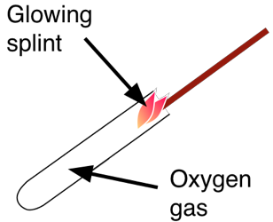
Identification of common gases
Test For Oxygen
The test for oxygen uses a glowing splint inserted into a test tube of the gas. The splint relights in oxygen.
You must learn this test, including how the gas is tested and the positive result that proves that the chemical is the gas you are testing for.

Slide 38
QuestionIT!
Earth and atmospheric science
Part 1
The Earth’s early atmosphere
Changes in atmospheric gases

Slide 39
Earth and atmospheric science – Part 1 – QuestionIT
What gases are believed to have been released from volcanoes during the first billion years of the Earth’s existence?
How did the oceans form?
Why did the amount of carbon dioxide in the earlier atmosphere decrease?
How do you test a gas for oxygen?

Slide 40
Earth and atmospheric science – Part 1 - QuestionIT
What organisms increased the amount of oxygen in the Earth’s atmosphere?
Write the balanced symbol equation for photosynthesis.
Other than photosynthesis, what other factors decreased the level of carbon dioxide in the atmosphere?
Describe the main changes to the atmosphere over time and the likely causes of these changes.

Slide 41
AnswerIT!
Earth and atmospheric science
Part 1
The Earth’s early atmosphere
Changes in atmospheric gases

Slide 42
Earth and atmospheric science – Part 1 QuestionIT
What gases are believed to have been released from volcanoes during the first billion years of the Earth’s existence?
Nitrogen, carbon dioxide, water vapour; small amounts of ammonia and methane.
How did the oceans form?
Water vapour in the atmosphere condensed.
Why did the amount of carbon dioxide in the earlier atmosphere decrease?
When oceans formed, carbon dioxide dissolved in the water; carbonates precipitated producing sediments, reducing carbon dioxide in the atmosphere.
How do you test for oxygen gas?
Glowing splint relights.

Slide 43
Earth and atmospheric science – Part 1 - QuestionIT
What organisms increased the amount of oxygen in the Earth’s atmosphere?
Primitive plants/ algae.
Write the balanced symbol equation for photosynthesis.
6CO₂ + 6H₂O C₆H₁₂O₆ + 6O₂
Other than photosynthesis, what other factors decreased the level of carbon dioxide in the atmosphere?
Formation of sedimentary rocks and fossil fuels (natural gas, oil, coal).

Slide 44
Earth and atmospheric science – Part 1 - QuestionIT
Describe the main changes to the atmosphere over time and the likely causes of these changes.
Intense volcanic activity – water vapour, carbon dioxide, nitrogen, ammonia, methane released.
Water vapour condensed to form oceans.
Atmosphere mostly carbon dioxide; nitrogen slowly building up over time.
Carbon dioxide dissolved in oceans; carbonates precipitated producing sediments. Carbon dioxide levels in atmosphere drop.
Photosynthesis – algae produce oxygen.
Plants evolved, levels of carbon dioxide reduced, levels of oxygen increased; animals evolved.
Carbon dioxide levels dropped during the formation of sedimentary rock (from sediments) and fossil fuels (from organisms).

Slide 45
LearnIT!
KnowIT!
Earth and atmospheric science
Part 2
The greenhouse effect and climate change
Composition of today’s atmosphere

Slide 46

Carbon dioxide and methane as greenhouse gases
Greenhouse gases in the atmosphere maintain temperatures on Earth high enough to support life. Examples of greenhouse gases are:
Carbon dioxide
Water vapour
Methane
You must know these three gases
CO₂
Visible light
Infra-red
Trapped in atmosphere warming it up
Absorbed then re-radiated
Infra-red
Visible light with a short wavelength is absorbed by the Earth, it is then re-radiated as longer wavelength infra red.
The longer wavelength infra red cannot penetrate through the greenhouse gas layer in the atmosphere which contains carbon dioxide and methane.

Slide 47
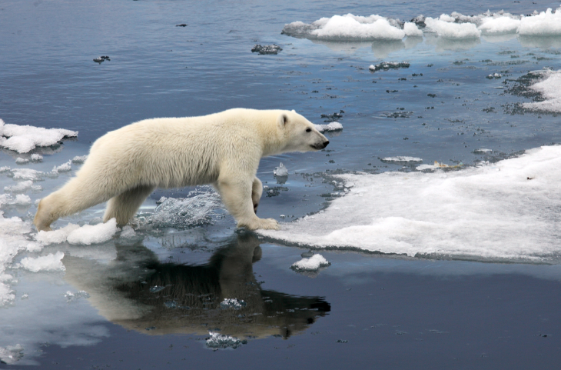
Carbon dioxide and methane as greenhouse gases
Some human activities increase the amounts of greenhouse gases in the atmosphere namely carbon dioxide and methane.
Two human activities that increase the amount of the greenhouse gas carbon dioxide are burning fossil fuels and deforestation.
Two human activities that increase the amount of the greenhouse gas methane are farming of livestock e.g. cows and pigs and landfills.
Based on peer-reviewed evidence, many scientists believe that human activities will cause the temperature of the Earth’s atmosphere to increase at the surface and that this will result in global climate change.
However it is difficult to model such complex systems as global climate change. There are also uncertainties caused by the location where these measurements are taken and questions over the accuracy of historical data.

Slide 48

The proportions of different gases in the atmosphere
For 200 million years, the proportions of different gases in the atmosphere have been much the same as they are today:
about four-fifths (approximately 80%) nitrogen
about one-fifth (approximately 20%) oxygen
small proportions of various other gases, including carbon dioxide, water vapour and noble gases.
You must learn these percentages for the exam
80% N₂
20% O₂
<1% CO₂, H₂O + Noble Gases

Slide 49
QuestionIT!
Earth and atmospheric science
Part 2
The greenhouse effect and climate change
Composition of today’s atmosphere

Slide 50
Earth and atmosphere part 2– QuestionIT
Name 3 greenhouse gases.
What is the link between greenhouse gases and the temperature of the Earth?
Name human activities which increase the amount of carbon dioxide in the atmosphere.
Name human activities that increase the amount of methane in the atmosphere.

Slide 51
Earth and atmosphere part 2– QuestionIT
What do many scientists believe about human activities and the temperature of the Earth’s atmosphere?
Why are there issues surrounding modelling human impact on climate change?
Name two gases and their compositions in today’s atmosphere.

Slide 52
AnswerIT!
Earth and atmospheric science
Part 2
The greenhouse effect and climate change
Composition of today’s atmosphere

Slide 53
Earth and atmosphere part 2– QuestionIT
Name 3 greenhouse gases.
Water vapour, carbon dioxide, methane.
What is the link between greenhouse gases and the temperature of the Earth?
Greenhouse gases maintain temperatures on the Earth high enough to support life.
Name human activities which increase the amount of carbon dioxide in the atmosphere.
Burning/ combustion of fossil fuels, deforestation.
Name human activities that increase the amount of methane in the atmosphere.
Farming of livestock; landfill sites.

Slide 54
Earth and atmosphere part 2– QuestionIT
What do many scientists believe about human activities and the temperature of the Earth’s atmosphere?
Human activities will cause the temperature of the Earth’s atmosphere to increase at the surface resulting in climate change.
Why are there issues surrounding modelling human impact on climate change?
It is difficult to model these changes
There are uncertainties caused by the location where the measurements are taken.
Questions regarding historical accuracy.
Name two gases and their compositions in today’s atmosphere.
Nitrogen (80%), Oxygen (20%)

